Slide 1
Lab on Cell-free Synthetic Biology - EE-490(j)
Sixth Week
14.10.2025

Slide 2
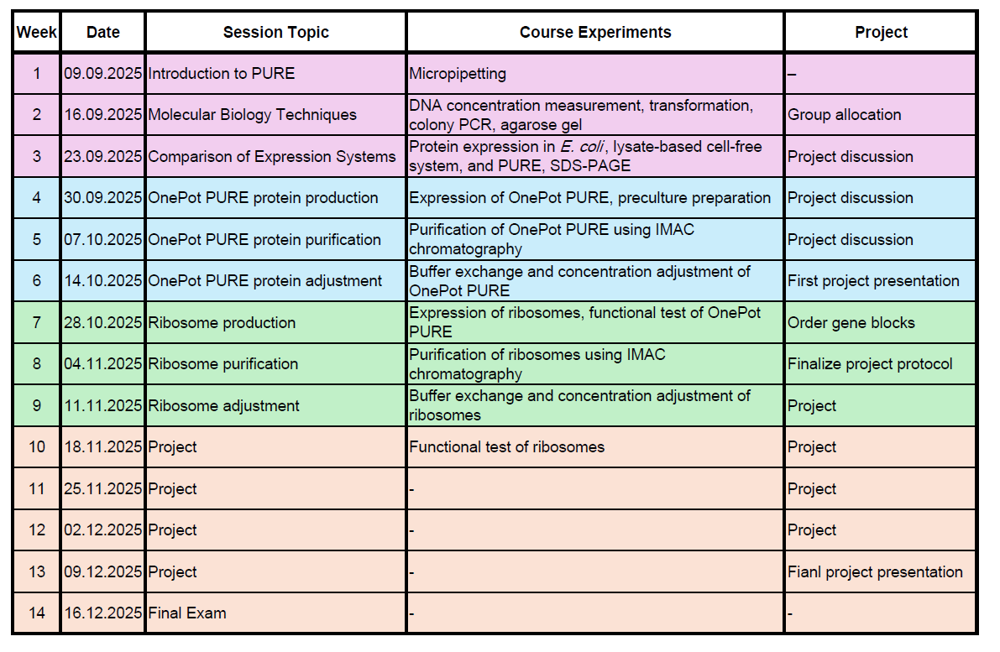
Course schedule

Slide 3
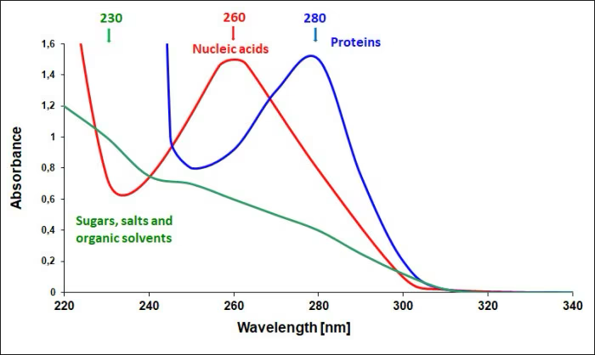
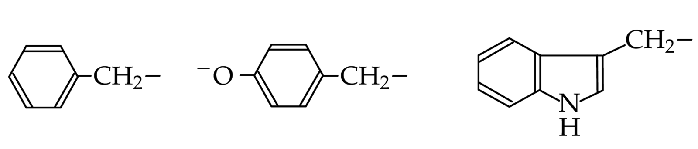
Protein Quantification by Spectroscopy
Beer-Lambert Law:
C = A/(L x ε)
  C: concentration
  L: path length
  ε: extinction coefficient
aromatic amino acids
Tyr Trp Phe
Less absorbance
https://www.eppendorf.com/my-en/lab-academy/life-science/cell-biology/uv-vis-spectrophotometry-easy-and-quick-quantification-of-nucleic-acids/

